Slide 1
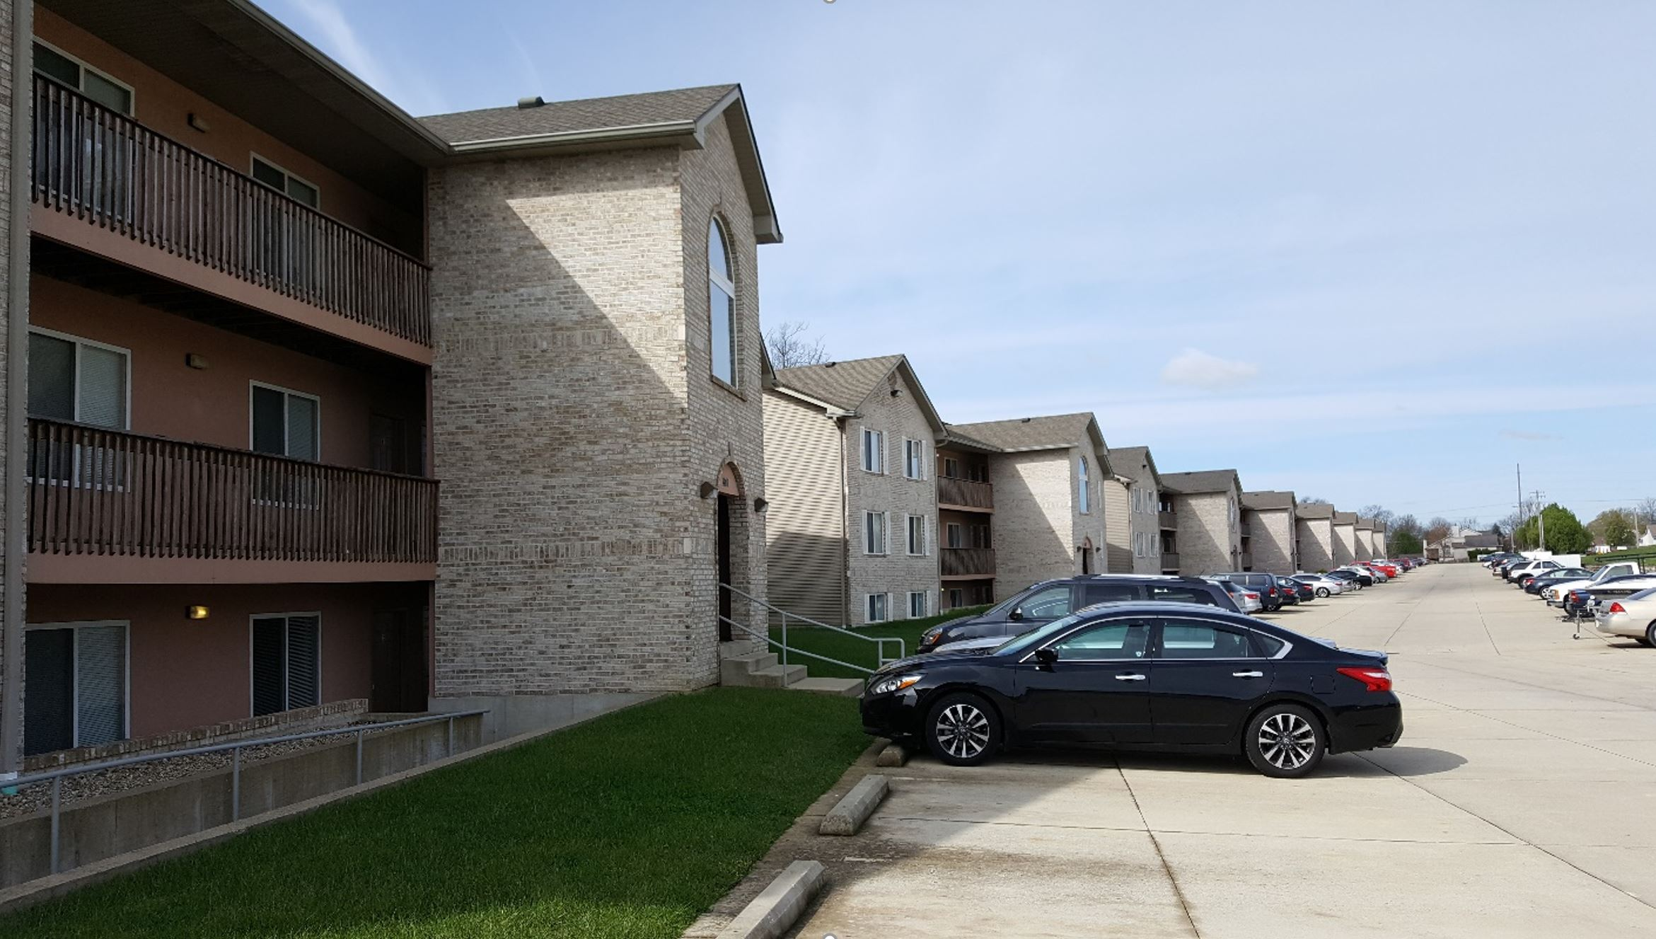
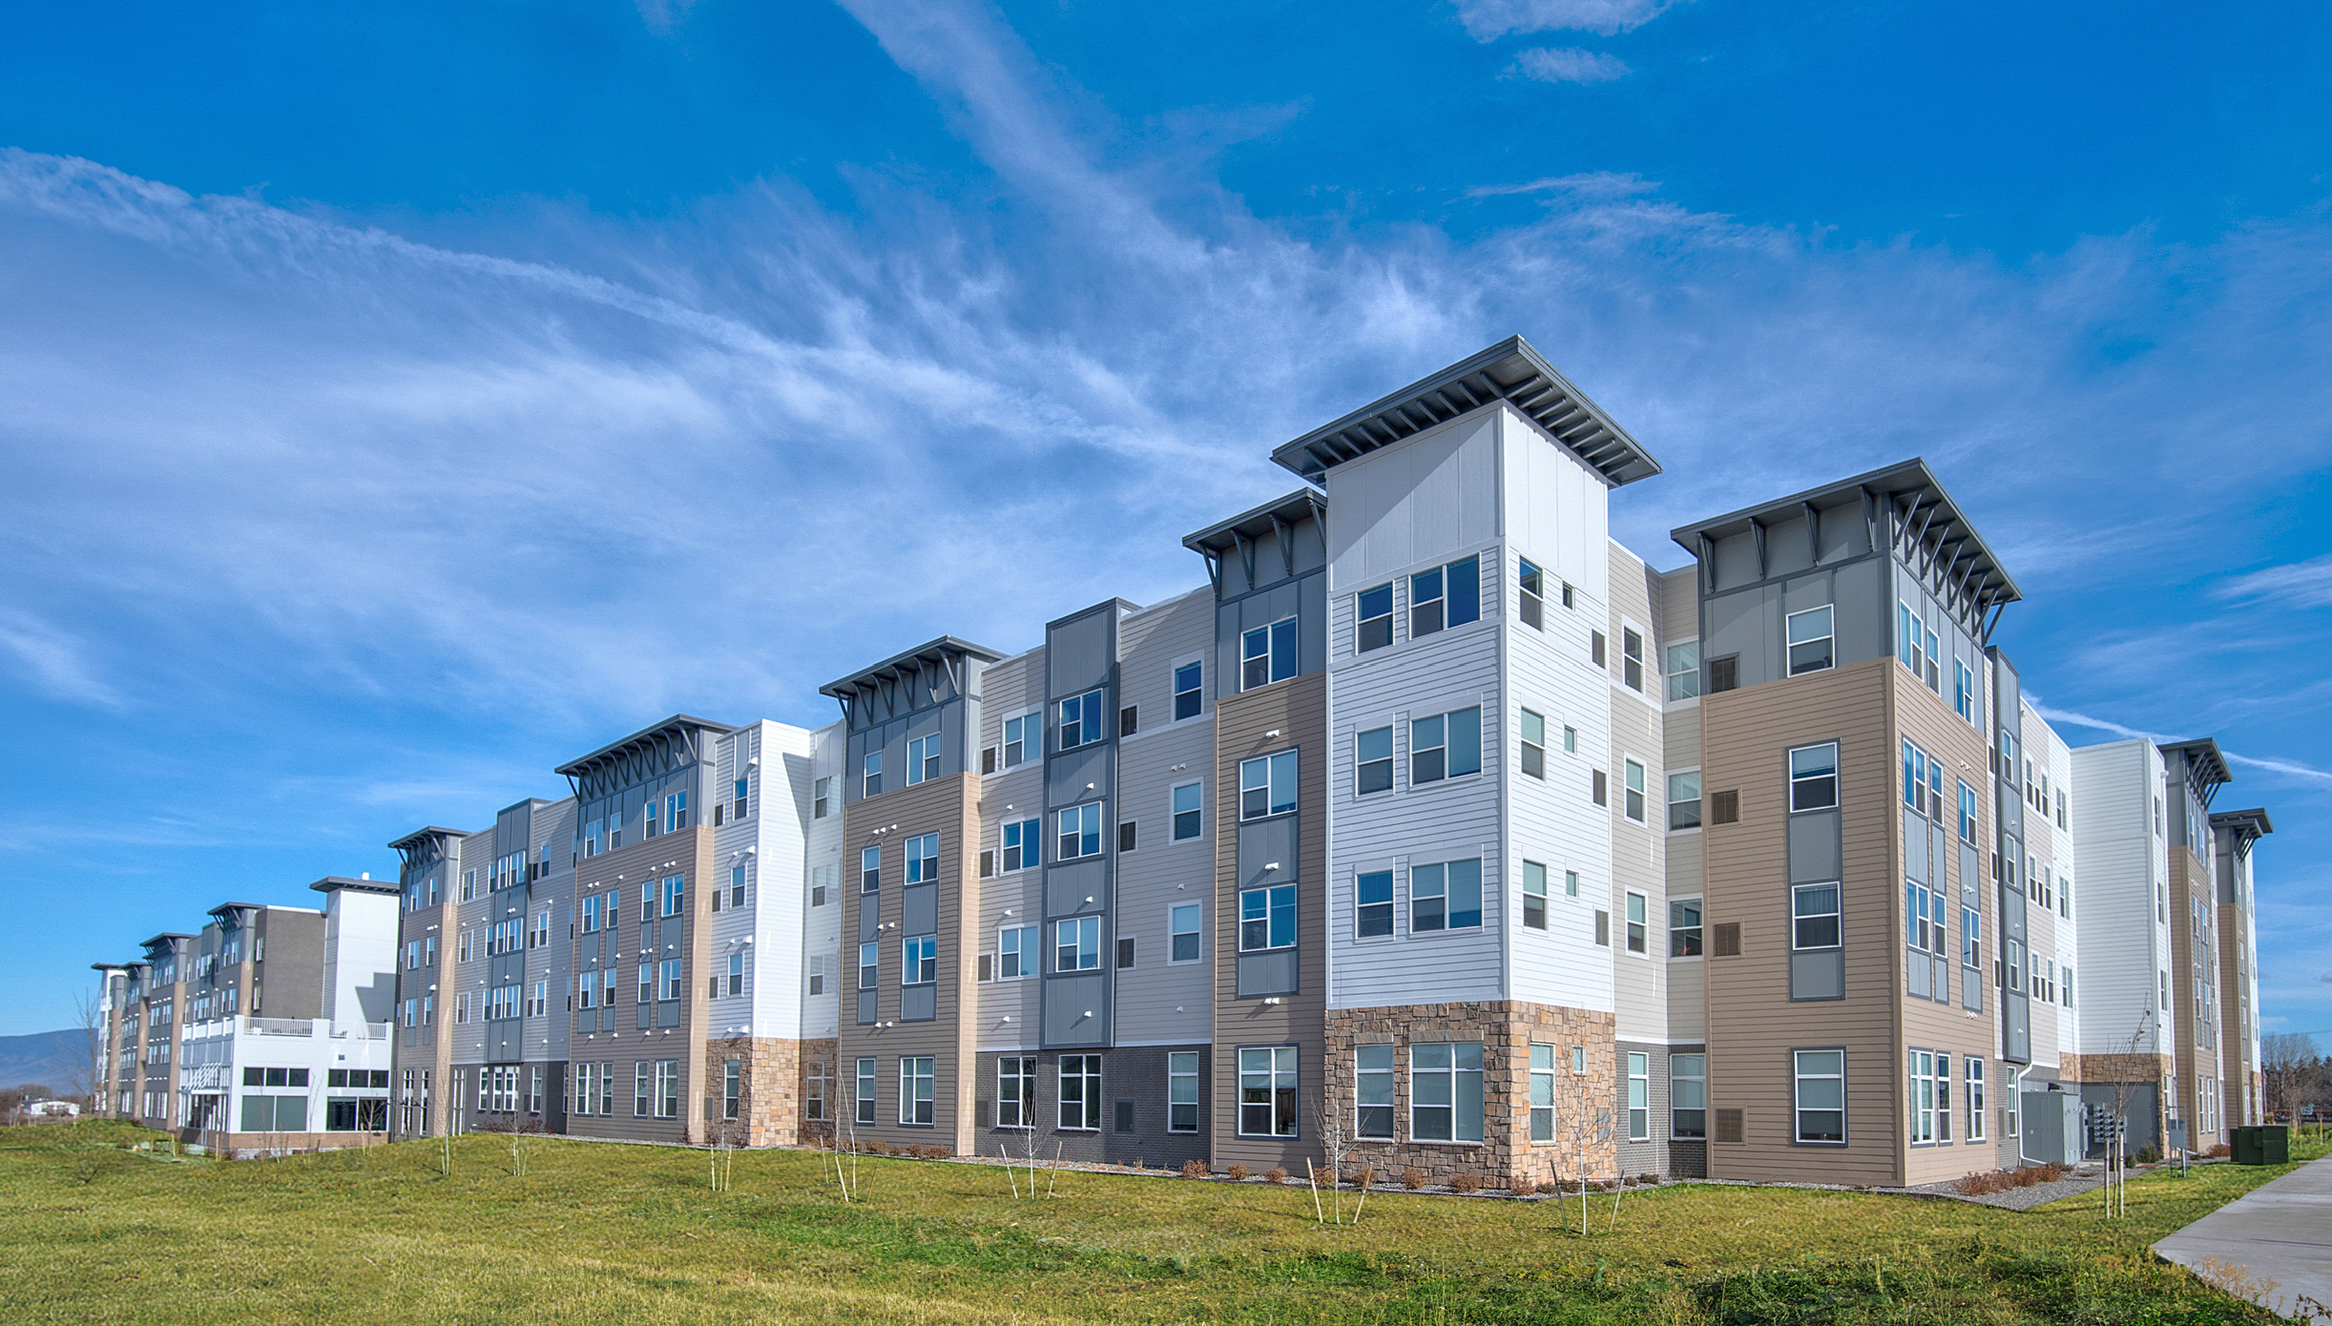


Does Your Multifamily Facility Qualify for Green Financial Benefits?
Presenter:
Eric Truelove, P.E., LEED AP, GGA, GGP, GGF
Principal and Founder
Green Building Resources LLC
Notes:
Welcome to the Green Building Resources Powerpoint on qualifying multifamily facilities for green financial benefits. Green Building Resources has have been in business since 2008 and have assisted with over 300 certified green building projects located across the United States. My name is Eric Truelove. I am Principal and Founder of Green Building Resources.

Slide 2
Good Candidates
Located in the United States
Rule of 100: At least 100 apartment units or at least 100,000 square feet
  Fees will run $25,000 to $35,000 for a successful candidate
  Benefits are generally proportional to the square feet
Does not have to be one continuous building
  A complex of two or more separate buildings on one continuous site can qualify
Constructed after 2010
  If a building is older, does it have major renovations to the mechanical and electrical equipment after 2010?

Slide 3
Financial Benefits Linked to Green
Energy efficiency is key
  Use actual energy use or an energy model
  Want an Energy Star Score of 80 or higher
  Renewable energy can be purchased and credited to the facility
Water conserving fixtures and appliances are a plus

Slide 4
Green Financial Benefits
Fannie Mae
  Form 4250
  Green Globes® certifications through the Green Building Initiative® (Pages 3 & 5)
  Two week turn-arounds can be achieved.
179D Tax Deduction
  Based on an energy model
  Typically, $1 per square foot

Slide 5
Green Building Resources LLC
Assisted in achieving Fannie Mae discount on over 200 multifamily facilities
Will provide no cost, no obligation reviews along with a cost quote
  Construction documents
  Property condition report (existing facilities)
  Phase I environmental report (helpful, but not mandatory)
  Contact us at 608-332-8444 or etruelove86@gmail.com

